Slide 1

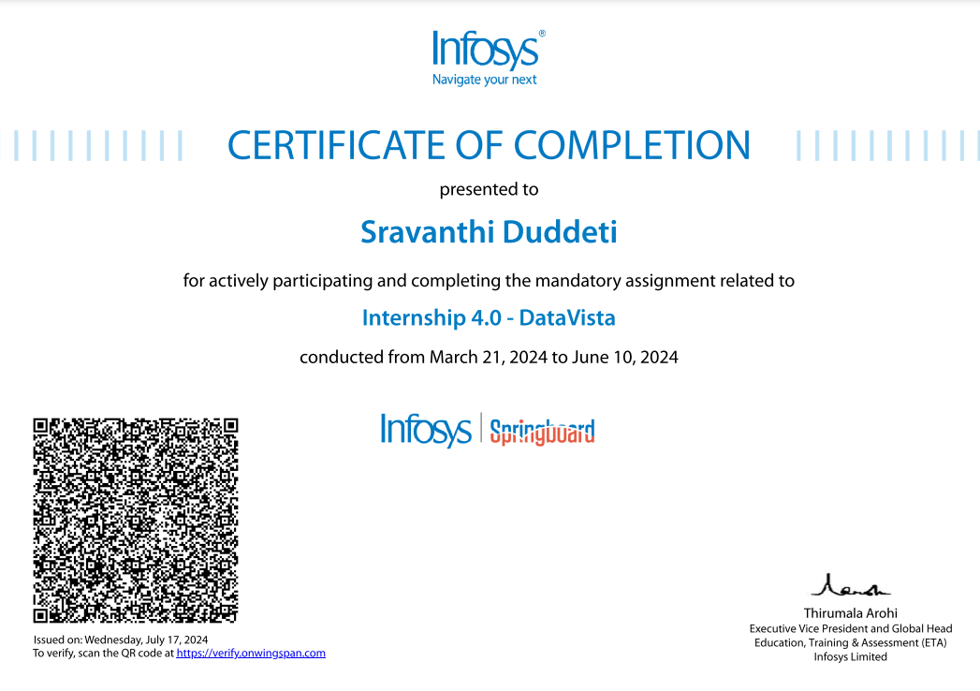
Infosys Springboard
Project - Data Vista

Slide 2

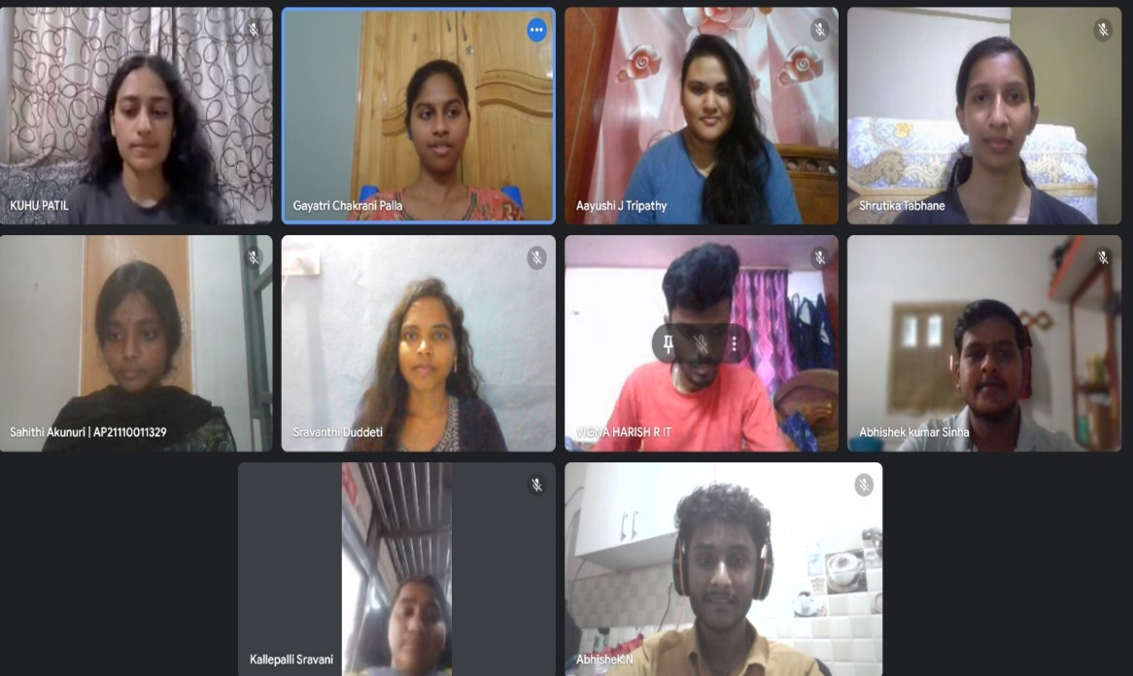
Meet The Group
AAYUSHI, Abhishek, Abhishek S., Asha, Gayatri,
Kuhu Patil, Sahiti, Shravanthi, Shrutika, Sravani, Vigna,Yash
The Members of the Team:
Mentor:
SUJATA

Slide 3



Table of contents
Project Objectives
About Dataset
Issues faced & Solutions
Chosen Technology Stack
The Final Product
Further Improvements
Conclusion: Key Takeaways
01
02
03
04
05
06
07

Slide 4




Project Objectives
Objective 01
Objective 02
Objective 03
Develop Role-Specific Data Visualizations:
Create informative and visually appealing Power BI dashboards tailored to the specific needs of different user roles (e.g., Sales Manager, Product Manager) for effective data exploration and analysis.
Secure User Access:
Establish a login system that verifies user credentials and restricts access to Power BI dashboards based on assigned roles.
Seamless Integration:
Integrate the login system with Power BI to automatically redirect users to their designated dashboard upon successful login.
1
Objectives
About Dataset
Issues & Solutions
Technology Stack
Final Product
Improvements
Conclusion

Slide 5


Introduction: About Dataset
Data Source: Kaggle.com
Size: 1 million rows
Sector: E-commerce
Data Fields:
Customer - (Customer ID, Name, Age, Sex, Address)
Location - (Customer ID, City, State, Region, Pincode)
Product - (Product ID, Name, Category, Price)
Order Details - (Customer ID, Order ID, Dates, Product ID, Quantity sold, Payment method, Cost, Sales, Profits, Reason ID, etc. details )
Order Return Reason - (Reason ID, Reason Description)
2
Ab
Objectives
About Dataset
Issues & Solutions
Technology Stack
Final Product
Improvements
Conclusion

Slide 6


Issues and solutions
01
Finding the proper data set with suitable size. - Custom data Generation.
02
Integrating Power BI reports with web page - Embedding the reports method.
03
Double login issue with integrated power BI reports in the web page - Removing the RLS.
3
Objectives
About Dataset
Issues & Solutions
Technology Stack
Final Product
Improvements
Conclusion

Slide 7







Technology Stack
4
Objectives
About Dataset
Issues & Solutions
Technology Stack
Final Product
Improvements
Conclusion

Slide 8

Final Product
DATA VISTA
Login Details:
Sl.No | Username | Password | Role
1 | KuhuPatil@DSU0136.onmicrosoft.com | Kuhu@1234 | Product Manager
2 | Abhishek@DSU0136.onmicrosoft.com | Appu@123 | Sales Manager
3 | Sahiti@DSU0136.onmicrosoft.com | Infosys@1234 | Product Team member
4 | Sravani@DSU0136.onmicrosoft.com | Infosys@1234 | Product Team member
5 | Shrutika@DSU0136.onmicrosoft.com | Infosys@1234 | Sales team member EAST
6 | Shravanthi@DSU0136.onmicrosoft.com | Infosys@1234 | Sales Team member MIDWEST
7 | Aayushi@DSU0136.onmicrosoft.com | Infosys@1234 | Sales Team member SOUTH
8 | Gayatri@DSU0136.onmicrosoft.com | Infosys@1234 | Sales Team member WEST
9 | Vigna@DSU0136.onmicrosoft.com | Infosys@1234 | Product Team member
10 | Asha@DSU0136.onmicrosoft.com | Infosys@1234 | Product Team member
5
Objectives
About Dataset
Issues & Solutions
Technology Stack
Final Product
Improvements
Conclusion

Slide 9


Improvements
01
Reducing the number of Power BI files by adding row level securities.
02
Using python visualization techniques instead of power BI.
03
Creating more interacrive visualization reports.
6
Objectives
About Dataset
Issues & Solutions
Technology Stack
Final Product
Improvements
Conclusion

Slide 10


Conclusion: Key Takeaways
Group work: Learned group work through communication, task management, and collaboration.
Tech Skills: Gained experience in Power BI, MySQL, Python and cloud computing.
Soft Skills: Enhanced soft skills like critical thinking, problem-solving, and communication.
Agile Learner: Thrived in a fast-paced environment, adapting to new technologies.
7
Objectives
About Dataset
Issues & Solutions
Technology Stack
Final Product
Improvements
Conclusion

Slide 11


Thank You!

